Slide 1

AE 482
Farm Machine Design
UNIT 5: Hydraulic Fluids
Mr. Joseph AVEYIRE
aveyire@yahoo.com // 024 4652593

Slide 2
Introduction
Unit four identifies hydraulic power transmission and hydraulic fluids.
Section 1-4 Describes hydraulic fluids, and
Section 2-4 On the other hand handles hydraulic components and their applications.

Slide 3
UNIT 4: Learning Objectives
Explains the principle of hydro-mechanics,
Describes the theory of lubrication,
Explains the classification of hydraulic fluids,
Explains the selection of hydraulic fluids

Slide 4
UNIT 4: Introduction
Fluid Power:
Fluid power is the technology that deals with the transfer and control of energy and signal by means of pressurised fluids.
The pressurised fluid can be either liquid or gas (i.e. hydraulics and pneumatics fluid power).

Slide 5
UNIT 4: Principles of Hydro-Mechanics
Hydraulic Transmission of Energy
There are two forms of science of hydraulics:
Hydrodynamics: deals with high velocities and low pressure (Principle of moment of momentum), and
Hydrostatics : involves high pressure and low pressures (Principles of positive displacement)
From this point onwards: Hydraulics will denote hydrostatics.

Slide 6
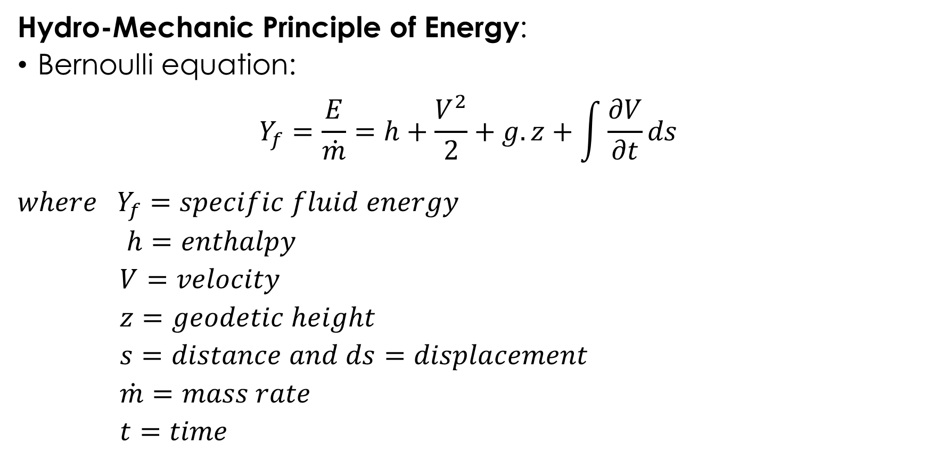
UNIT 4: Principles of Hydro-Mechanics
Hydro-Mechanic Principle of Energy:
Bernoulli equation:
$$Y_{f}=\frac{E}{\dot{m}}=h+\frac{V^{2}}{2}+g.z+\int{\frac{∂V}{∂t}ds}$$
$$where Y_{f}=specific fluid energy$$
$$h=enthalpy$$
$$V=velocity$$
$$z=geodetic height$$
$$s=distance and ds=displacement$$
$$\dot{m}=mass rate$$
$$t=time$$

Slide 7

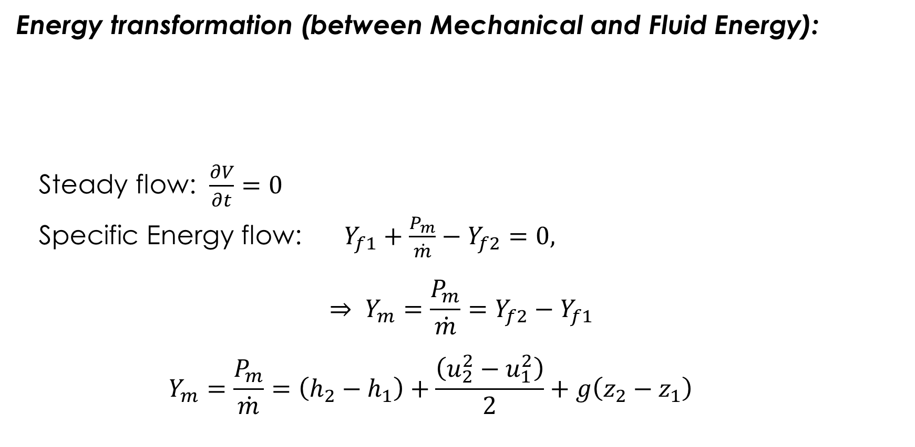


UNIT 4: Principles of Hydro-Mechanics
Energy transformation (between Mechanical and Fluid Energy):
Steady flow: $\frac{∂V}{∂t}=0$
Specific Energy flow: $Y_{f1}+\frac{P_{m}}{\dot{m}}−Y_{f2}=0,$
$$⇒ Y_{m}=\frac{P_{m}}{\dot{m}}=Y_{f2}−Y_{f1}$$
$$Y_{m}=\frac{P_{m}}{\dot{m}}=\left(h_{2}−h_{1}\right)+\frac{\left(u_{2}^{2}−u_{1}^{2}\right)}{2}+g\left(z_{2}−z_{1}\right)$$
$$P_{f1}=\dot{m}.Y_{f1}$$
Pump / Motor
$$P_{f2}=\dot{m}.Y_{f2}$$
$$P_{m}$$

Slide 8
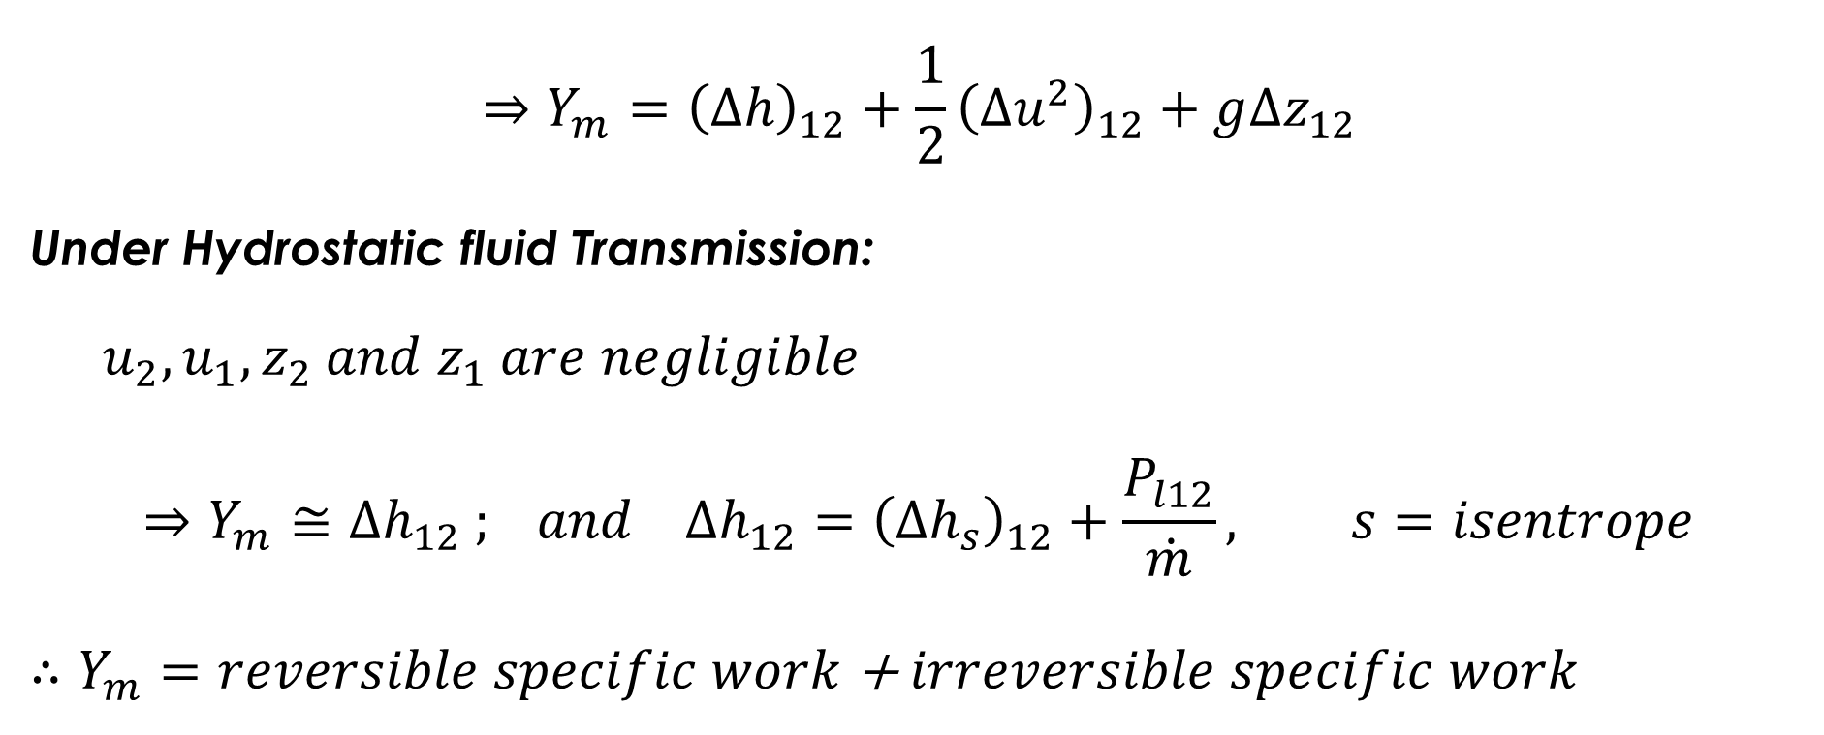
UNIT 4: Principles of Hydro-Mechanics
$$⇒Y_{m}={\left(∆h\right)}_{12}+{\frac{1}{2}\left(∆u^{2}\right)}_{12}+g∆z_{12}$$
Under Hydrostatic fluid Transmission:
$$u_{2},u_{1}, z_{2} and z_{1} are negligible$$
$$⇒Y_{m}≅∆h_{12} ; and ∆h_{12}={\left(∆h_{s}\right)}_{12}+\frac{P_{l12}}{\dot{m}}, s=isentrope$$
$∴Y_{m}=$ $reversible specific work$ + $irreversible specific work$

Slide 9
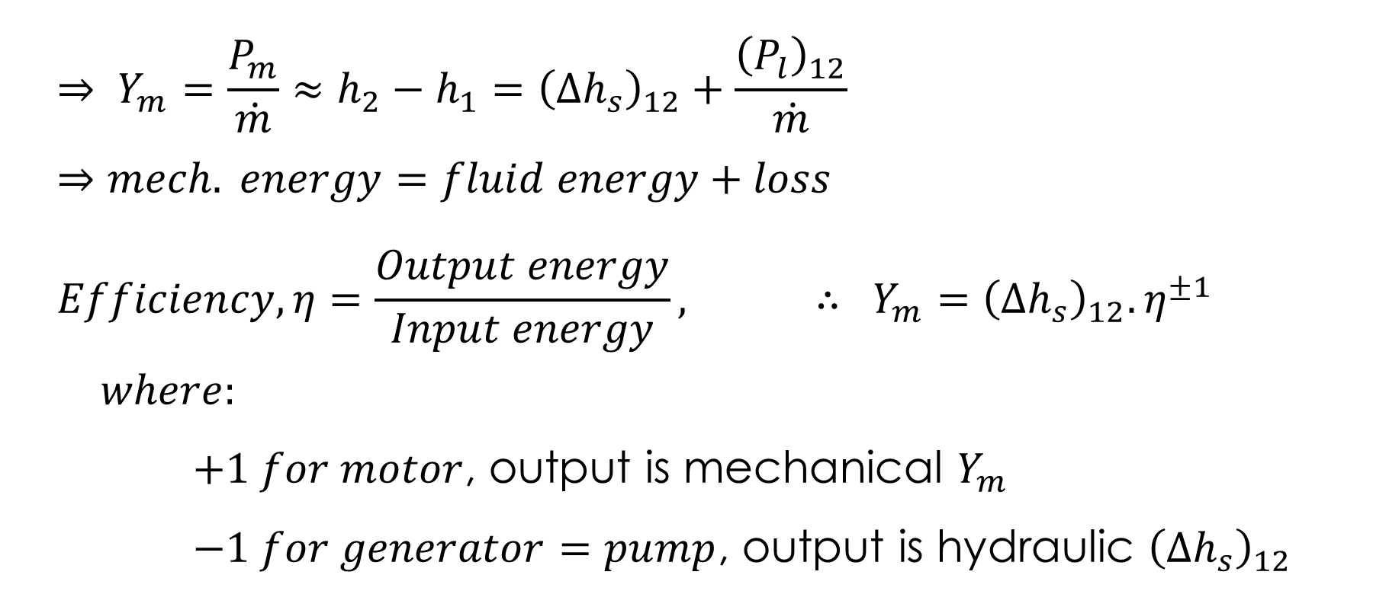
UNIT 4: Principles of Hydro-Mechanics
$$⇒ Y_{m}=\frac{P_{m}}{\dot{m}}≈h_{2}−h_{1}={\left(∆h_{s}\right)}_{12}+\frac{{\left(P_{l}\right)}_{12}}{\dot{m}}$$
$$⇒mech. energy=fluid energy+loss$$
$$Efficiency, η=\frac{Output energy}{Input energy}, ∴ Y_{m}={\left(∆h_{s}\right)}_{12}.η^{±1}$$
$$where:$$
$+1 for motor$, output is mechanical $Y_{m}$
$−1 for generator=pump$, output is hydraulic ${\left(∆h_{s}\right)}_{12}$

Slide 10
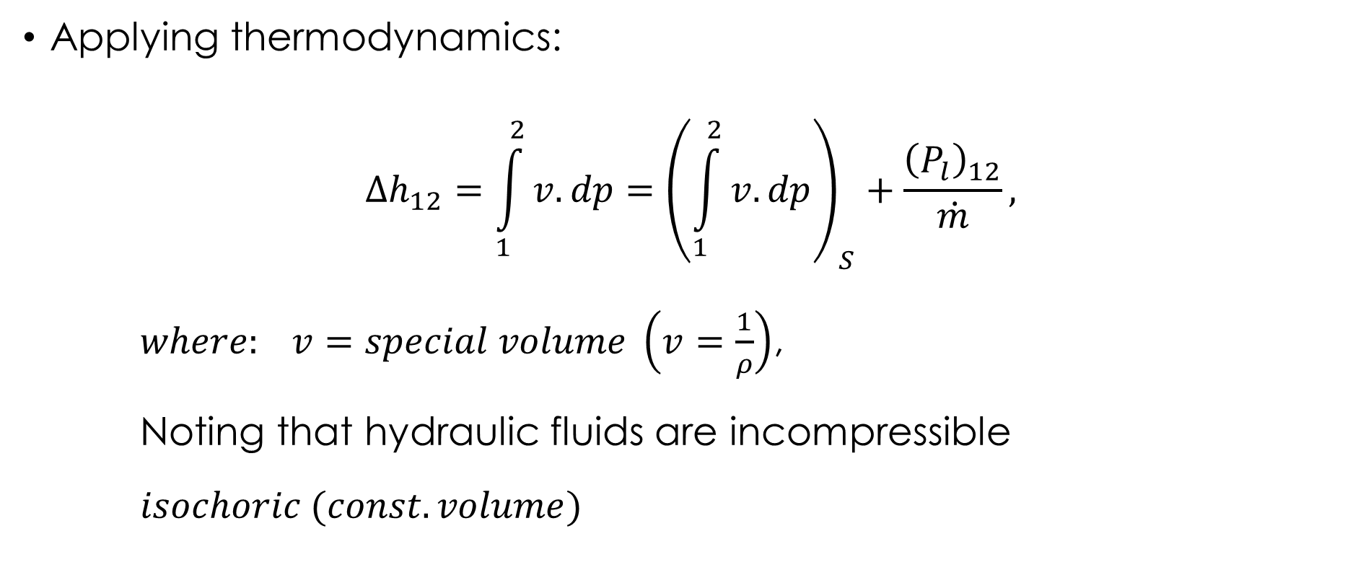
UNIT 4: Principles of Hydro-Mechanics
Applying thermodynamics:
$$∆h_{12}=\int_{1}^{2}{v.dp}={\left(\int_{1}^{2}{v.dp}\right)}_{S}+\frac{{\left(P_{l}\right)}_{12}}{\dot{m}},$$
$where: v=special volume \left(v=\frac{1}{ρ}\right)$,
Noting that hydraulic fluids are incompressible
$$isochoric (const. volume)$$

Slide 11
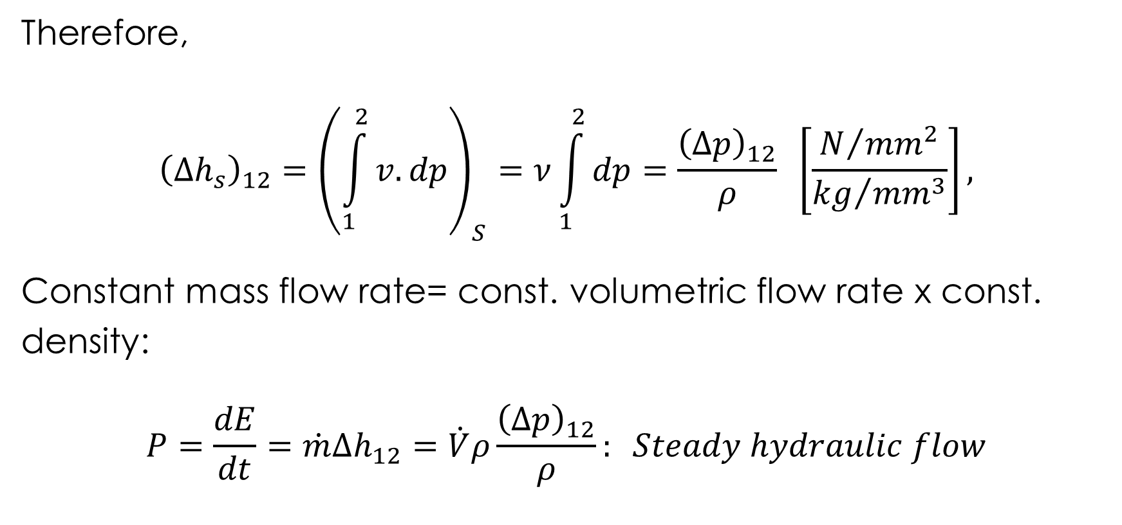
UNIT 4: Principles of Hydro-Mechanics
Therefore,
$${\left(∆h_{s}\right)}_{12}={\left(\int_{1}^{2}{v.dp}\right)}_{S}=ν\int_{1}^{2}{dp}=\frac{{\left(Δp\right)}_{12}}{ρ} \left[\frac{N/{{mm}^{2}}}{{kg}/{{mm}^{3}}}\right],$$
Constant mass flow rate= const. volumetric flow rate x const. density:
$$P=\frac{dE}{dt}=\dot{m}Δh_{12}=\dot{V}ρ\frac{{\left(Δp\right)}_{12}}{ρ}: Steady hydraulic flow$$

Slide 12
UNIT 4: Comparison of Energy Transmission
Comparison of Hydraulic Force/Energy Transmission to other Forms:
Criteria | Mechanical | Hydraulic | Electrical
Force Density | very good | good | bad
Transmission Distance | bad | good | very good
Control | bad | good | good
Safety | Approximately the same
Efficiency | good | bad | bad
Flexibility in structure | bad | good | very good
Cost of elements | expensive | expensive | cheap
Size | big | small | big

Slide 13
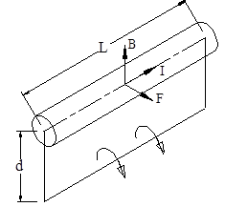
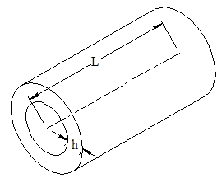
UNIT 4: Electrical-Mechanical Energy Conversion
Advantages of Hydraulic Controls and Drives:
Force Density: Electric motor
A conductor carrying an electric electrical current in a magnetic field experiences an electrical force governed by the Fleming’s left-hand rule (As in Electric motor).

Slide 14
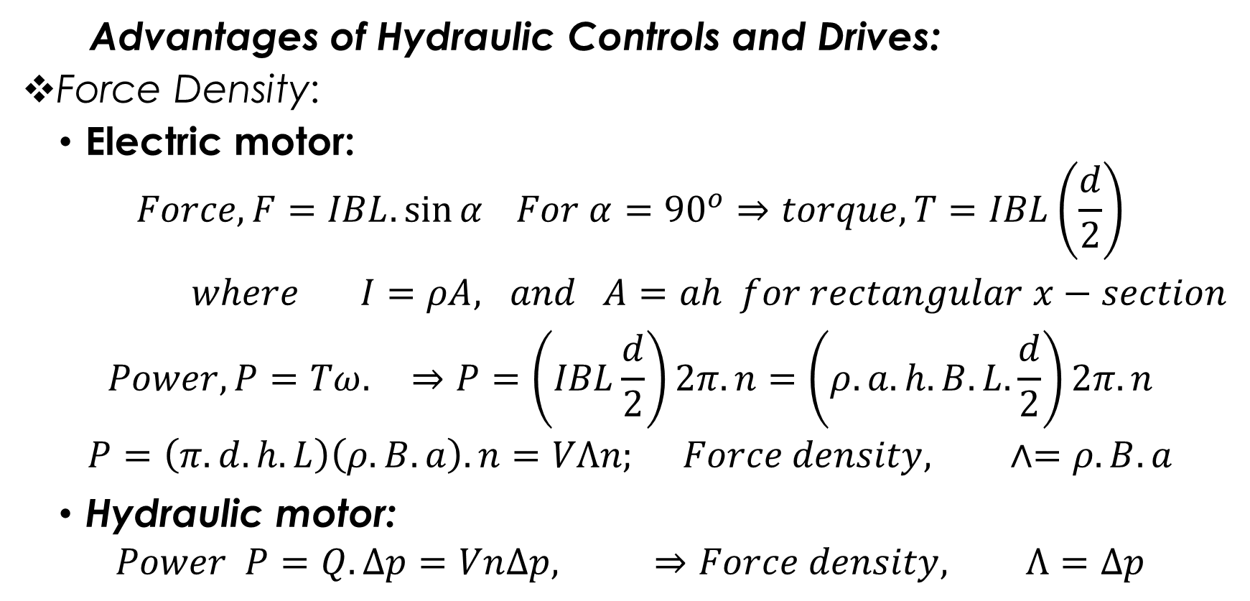
UNIT 4: Electrical-Mechanical Energy Conversion
Advantages of Hydraulic Controls and Drives:
Force Density:
Electric motor:
$$Force, F=IBL.\sin{α} For α={90}^{o}⇒torque, T=IBL\left(\frac{d}{2}\right)$$
$where I=ρA, and A=ah for rectangular x−section$
$$Power, P=Tω. ⇒P=\left(IBL\frac{d}{2}\right)2π.n=\left(ρ.a.h.B.L.\frac{d}{2}\right)2π.n$$
$$P=\left(π.d.h.L\right)\left(ρ.B.a\right).n=VΛn; Force density, ∧=ρ.B.a$$
Hydraulic motor:
$$Power P=Q.∆p=Vn∆p, ⇒Force density, Λ=∆p$$

Slide 15
UNIT 4: Fluid Energy Transmission
Advantages of Hydraulic Controls and Drives:
Distance: transfer of energy within moderate distance possible with hoses and pipes,
Control: hydraulic control parameters are volumetric flow rate and pressure. There are simple standard parts available for both hydraulic and electrical transmissions controls.
Efficiency: Low due to presence of complex resistance (ohm, capacitance and inductance) in hydraulic transmissions
Size: hydraulic motors are small due to high force density.

Slide 16
UNIT 4: Fluid Energy Transmission
Disadvantages of Hydraulic Controls and Drives:
High Losses: Due to fluid friction in flows through pipes, hoses, changes in cross-sectional area; and losses due to leakages at high pressure and clearances.
Sensitivity: Sensitive to foreign particles.
Dependence: Depends on the properties of the fluid (maxi. Temperature, compressibility)
Slip: Slip during rotation (n)
Danger: Leakages and bursting of pipes are dangers to life and property.
Low-life: The high force density results in high frictional wear

Slide 17
UNIT 4: Fluid Energy Transmission
Applications of Fluid Power transmission:
Fluid power is pervasive
Gas springs in office chairs
Air drills used by dentists,
Brakes in automobiles,
Practically to every large agriculture, construction and mining machine including harvesters, drills and excavators.

Slide 18
UNIT 4: Principles of Hydro-Mechanics
Hydrostatics
The principles of hydrostatics hold only under ideal fluids, which are:
Massless: no presence of kinetic energy
Frictionless: it is not viscous, and
Incompressible: volume does not change with pressure.
Therefore, experience no losses during operation.

Slide 19
UNIT 4: Principles of Hydro-Mechanics
Hydrostatics
Fundamentals of hydrostatics is the principle of Pascal:
“The effect of a force on fluid at rest, propagates itself in all directions within the fluid. The magnitude of the pressure in the fluid is equal the loading force acting at the effective surface. The pressure acts always at right angle on the boundary surface”.

Slide 20

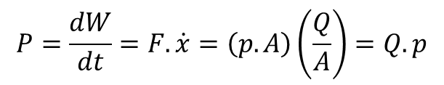







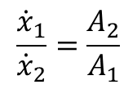


UNIT 4: Principles of Hydro-Mechanics
Hydrostatics: linear motion
For ideal fluid and no leakage:
Pressure:
$$p=\frac{F_{1}}{A_{1}}=\frac{F_{2}}{A_{2}}$$
$$F_{1}$$
$$F_{2}$$
$$x_{2}$$
Volume:
$$V=x_{1}.A_{1}=x_{2}.A_{2}$$
$$x_{1}$$
Velocity:
$$\frac{{\dot{x}}_{1}}{{\dot{x}}_{2}}=\frac{A_{2}}{A_{1}}$$
$$A_{1}$$
Law of Continuity:
p
p
$$A_{2}$$
$$Q={\dot{x}}_{1}.A_{1}={\dot{x}}_{2}.A_{2}$$
Work by piston:
$$W=F_{1}.x_{1}=−F_{2}.x_{2}$$
Figure 5.5: Pascal principle for linear motion
Power:
$$P=\frac{dW}{dt}=F.\dot{x}=\left(p.A\right)\left(\frac{Q}{A}\right)=Q.p$$

Slide 21






UNIT 4: Principles of Hydro-Mechanics
Hydrostatics: rotational motion
Q
$$n_{1}$$
$$n_{2}$$
$$v_{1}$$
Pump
Motor
$$v_{2}$$
$$T_{2}$$
$$T_{1}$$
Tank
Figure 5.6: Hydrostatic drive train

Slide 22



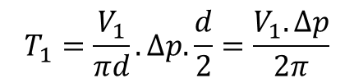


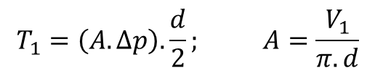

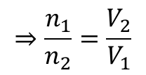


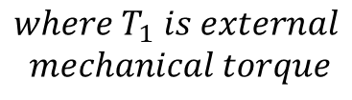
UNIT 4: Principles of Hydro-Mechanics
Hydrostatics: rotational motion
For ideal fluid and no leakage:
Pump
Motor
Low pressure
Piston
Volume:
High pressure
$$V_{1}=π.d.A$$
$$V_{2}=π.d.A$$
Discharge:
$$Q_{1}=V_{1}.n_{1}$$
$$Q_{2}=V_{2}.n_{2}$$
T
Ring cylinder
$$⇒\frac{n_{1}}{n_{2}}=\frac{V_{2}}{V_{1}}$$
$$Q_{1}=Q_{2}$$
$$φ$$
$$\frac{d}{2}$$
Torque:
$$T_{1}=\left(A.∆p\right).\frac{d}{2}; A=\frac{V_{1}}{π.d}$$
$$T_{1}=\frac{V_{1}}{πd}.∆p.\frac{d}{2}=\frac{V_{1}.∆p}{2π}$$
$$where T_{1} is external$$
$$mechanical torque$$
Figure 5.6: Model of a positive displacement machine
$$P_{1}=T_{1}.ω_{1}=Q_{1}.∆p$$

Slide 23
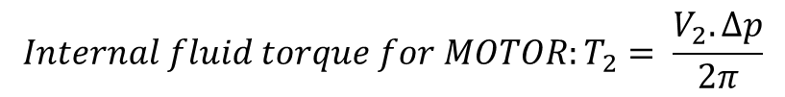

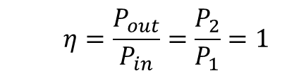
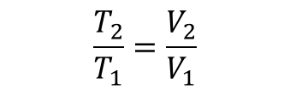



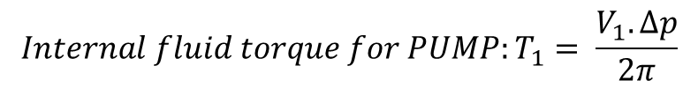
UNIT 4: Principles of Hydro-Mechanics
Hydrostatics: rotational motion
Torque transfer between Pump and Motor
As in Figure 5.6, where $∆p$ is the same for pump and motor
$${Internal fluid torque for PUMP:T}_{1}= \frac{V_{1}.∆p}{2π}$$
$$⇒ \frac{∆p}{2π}=\frac{T_{1}}{V_{1}}=\frac{T_{2}}{V_{2}}$$
$$\frac{T_{2}}{T_{1}}=\frac{V_{2}}{V_{1}}$$
Or
$${Internal fluid torque for MOTOR:T}_{2}= \frac{V_{2}.∆p}{2π}$$
Efficiency of ideal hydrostatic transmission:
For loss-free operation, the output hydraulic power is equal the input mechanical power
$${Pump: P}_{1}=T_{1}.ω_{1}=Q_{1}.∆p$$
$$η=\frac{P_{out}}{P_{in}}=\frac{P_{2}}{P_{1}}=1$$
Where $P_{1}$ and $P_{2}$ are mechanical power
$${Motor: P}_{2}=T_{2}.ω_{2}=Q_{2}.∆p$$

Slide 24



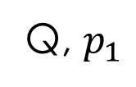

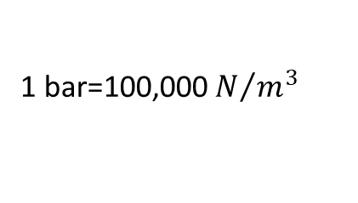

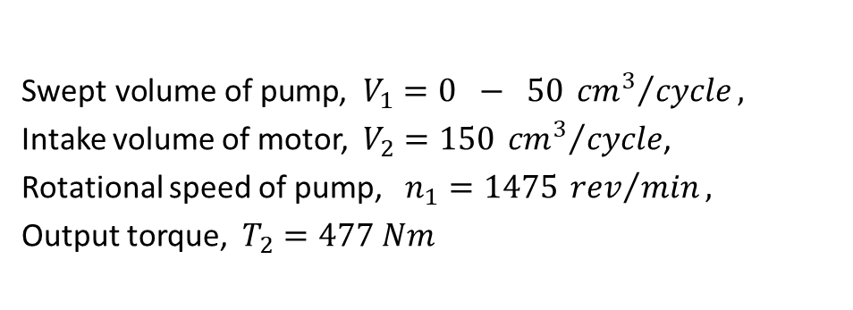


UNIT 4: Principles of Hydro-Mechanics
Example: A loss-free hydrostatic drive train in an opened circuit has been assigned the following data:
$\text{Swept} \text{volume} \text{of} \text{pump}$, $V_{1}=0 − 50 {{cm}^{3}}/{cycle},$
Intake volume of motor, $V_{2}=150 {{cm}^{3}}/{cycle}$,
Rotational speed of pump, $n_{1}=1475 {rev}/{min},$
Output torque, $T_{2}=477 Nm$
Q, $p_{1}$
$$n_{1}$$
$$n_{2}$$
$$v_{1}$$
Pump
Motor
$$v_{2}$$
$$T_{2}$$
$$T_{1}$$
1 bar=100,000 $N/{m^{3}}$
$$p_{T}=0$$
Tank

Slide 25
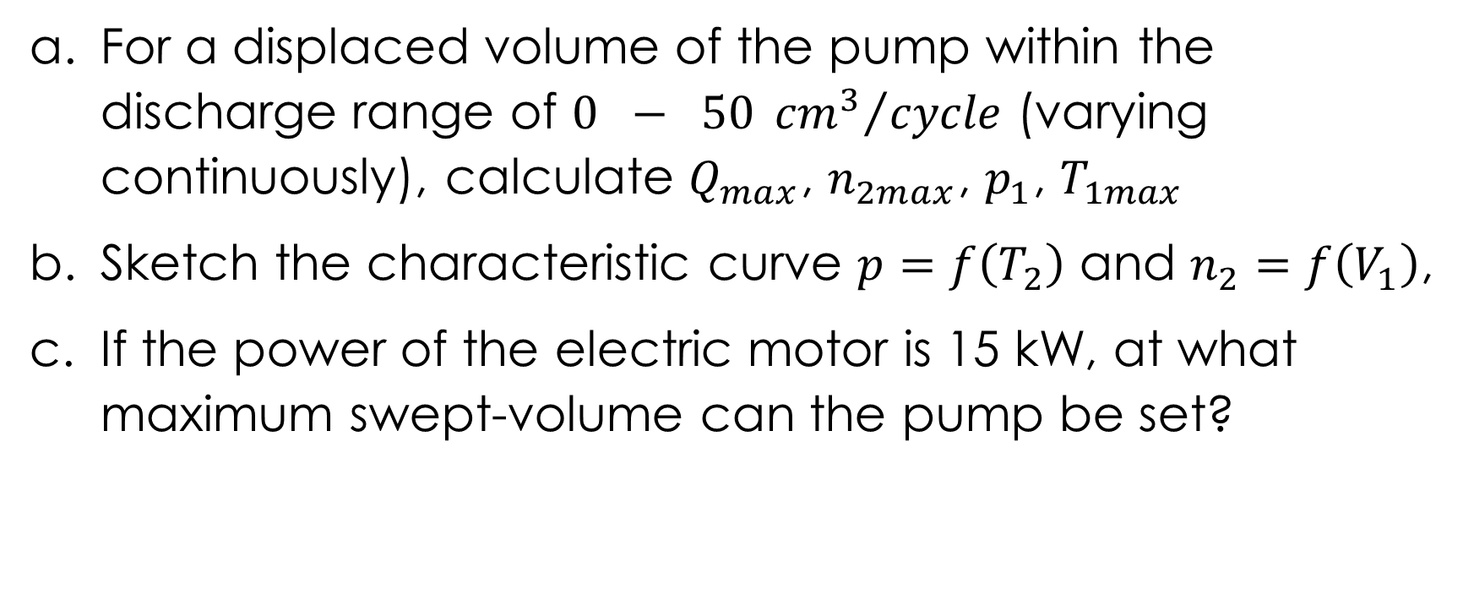
UNIT 4: Principles of Hydro-Mechanics
For a displaced volume of the pump within the discharge range of $0 − 50 {{cm}^{3}}/{cycle}$ (varying continuously), calculate $Q_{max}$, $n_{2max}$, $p_{1}$, $T_{1max}$
Sketch the characteristic curve $p=f\left(T_{2}\right)$ and $n_{2}=f\left(V_{1}\right)$,
If the power of the electric motor is 15 kW, at what maximum swept-volume can the pump be set?

Slide 26
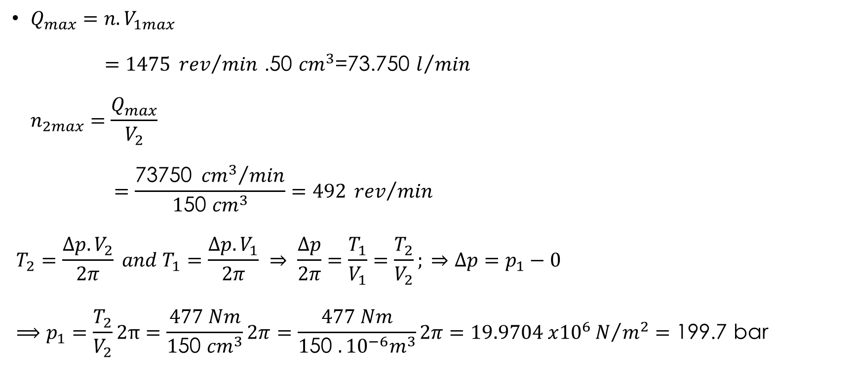
UNIT 4: Principles of Hydro-Mechanics
$Q_{max}=n.V_{1max}$
$=1475 {rev}/{min}$ .50 ${cm}^{3}$=73.750 $l/{min}$
$$n_{2max}=\frac{Q_{max}}{V_{2}}$$
$$=\frac{\text{73750 }{{cm}^{3}}/{min}}{1\text{50 }{cm}^{3}}=492 {rev}/{min}$$
$$T_{2}=\frac{∆p.V_{2}}{2π} and T_{1}=\frac{∆p.V_{1}}{2π} ⇒ \frac{∆p}{2π}=\frac{T_{1}}{V_{1}}=\frac{T_{2}}{V_{2}}; ⇒∆p=p_{1}−0$$
$$⟹p_{1}=\frac{T_{2}}{V_{2}}2π=\frac{477 Nm}{1\text{50 }{cm}^{3}}2π=\frac{477 Nm}{1\text{50 }{.{10}^{−6}m}^{3}}2π=19.9704 x{10}^{6}N/{m^{2}}=\text{199.7 }\text{bar}$$

Slide 27
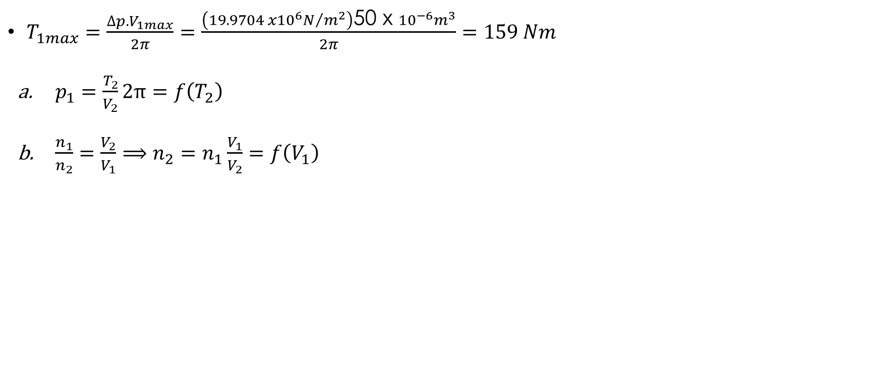
UNIT 4: Principles of Hydro-Mechanics
$T_{1max}=\frac{∆p.V_{1max}}{2π}=\frac{\left(19.9704 x{10}^{6}N/{m^{2}}\right)\text{50 }\text{x} {10}^{−6}m^{3}}{2π}=159 Nm$
$p_{1}=\frac{T_{2}}{V_{2}}2π=f\left(T_{2}\right)$
$\frac{n_{1}}{n_{2}}=\frac{V_{2}}{V_{1}}⟹n_{2}=n_{1}\frac{V_{1}}{V_{2}}=f\left(V_{1}\right)$

Slide 28
UNIT 4: Theory of Lubrication
Design and construction of machines are based on certain criteria such as:
Operational safety dimensioning and shaping of machine elements for a given expected life-span depend upon:
forces
Geometric form
Material of element
Guaranteed functioning of a machine depends on:
co-existence of pairing elements at the point of contact (Technical mating system=Fits and Tolerance)

Slide 29
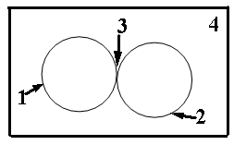
UNIT 4: Theory of Lubrication
Technical Mating System
The elements found within the technical mating system are:
  Primary body,
  Secondary body,
  Intermediary medium and
  Environment.
Properties of the elements are:
  Material properties of the elements,
  Form properties of the elements and
  Surface properties of the elements.

Slide 30
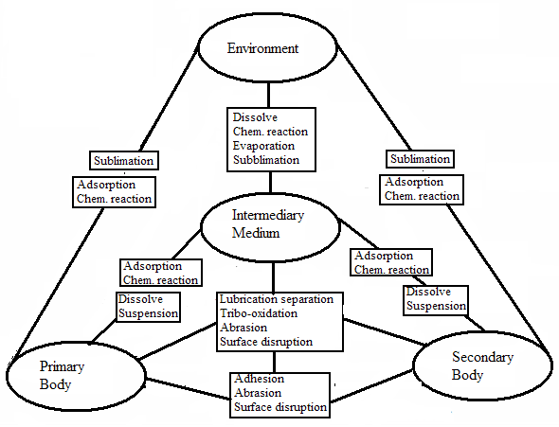
UNIT 4: Theory of Lubrication
Technical Mating System
Interactions
Example primary body and environment:
Sublimation
Adsorption
Chemical reaction

Slide 31
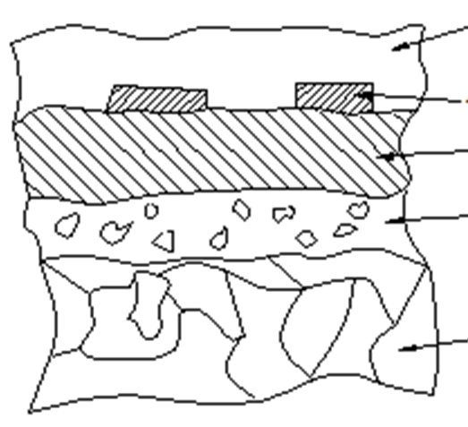
UNIT 4: Theory of Lubrication
Technical Mating System
Metallic Surface:
Consists of:
Impurities
Absorbed gases
On top of metallic surfaces:
Oxide layer
Cold-worked layer
Base material

Slide 32
UNIT 4: Theory of Lubrication
Wear
It is the progressive loss of material on surface of a solid body.
It is due to contact and relative motion of a solid body to a solid, liquid or gas medium
It is recognized by:
Presence of loose particles,
Change in material properties, and
Change in form.

Slide 33
UNIT 4: Theory of Lubrication
Factors Affecting Wear
Type of motion (sliding, rolling, impact etc.)
Trend of motion (continuous, intermittent, reversible, oscillation)
Forces/stresses (compression, tensile, etc)
Speed
Temperature
Duration or distance travelled
Properties of material
Form and nature of contact surfaces eg concave-convex surfaces, roughness

Slide 34
UNIT 4: Theory of Lubrication
Types of Wear (Mechanisms of Wear)
Tribo-oxidation (Oxidative Wear) is the removal of oxide-layer (layer activated by surface friction, medium and environment)
Adhesive Wear is characterised by building and breaking down of “welded” bridges (First, requires the break-down of the oxide-layer)
Abrasive Wear caused either by hard tips surface-profile or by the presence of hard foreign particles
Surface Disruption (surface fatigue) characterised by micro-cracks and breaking away of surface particles due to alternating mechanical stress . E.g.. pitting

Slide 35
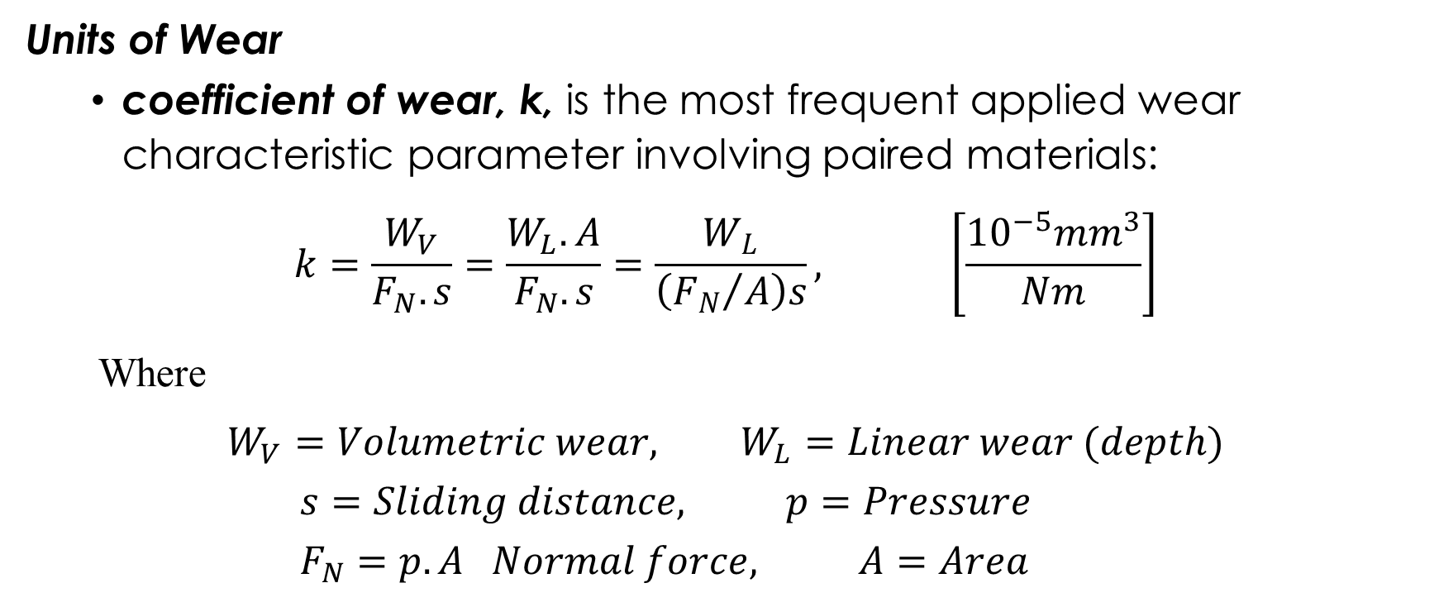
UNIT 4: Theory of Lubrication
Units of Wear
coefficient of wear, k, is the most frequent applied wear characteristic parameter involving paired materials:
$$k=\frac{W_{V}}{F_{N}.s}=\frac{W_{L}.A}{F_{N}.s}=\frac{W_{L}}{\left({F_{N}}/A\right)s}, \left[\frac{{10}^{−5}{mm}^{3}}{Nm}\right]$$
Where
$$W_{V}=Volumetric wear, W_{L}=Linear wear (depth)$$
$$s=Sliding distance, p=Pressure$$
$$F_{N}=p.A Normal force, A=Area$$

Slide 36
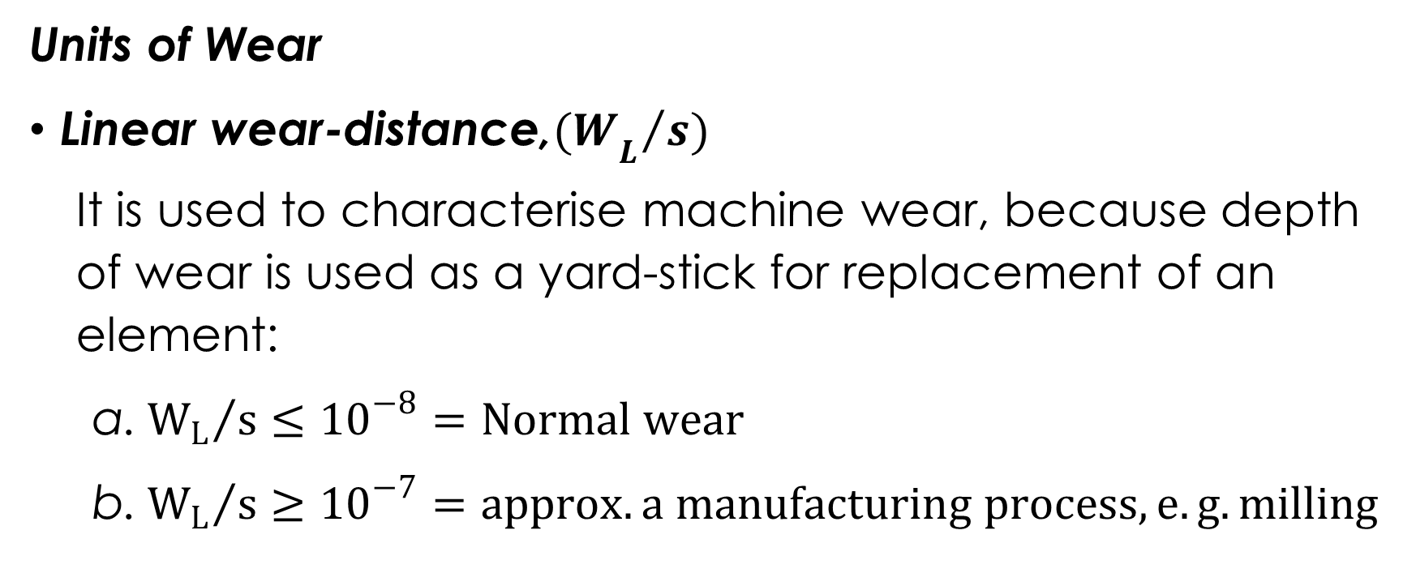
UNIT 4: Theory of Lubrication
Units of Wear
Linear wear-distance,${{(W}_{L}}/{s)}$
It is used to characterise machine wear, because depth of wear is used as a yard-stick for replacement of an element:
${W_{L}}/s≤{10}^{−8}=Normal wear$
${W_{L}}/s≥{10}^{−7}=approx. a manufacturing process, e.g. milling$

Slide 37
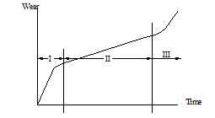
UNIT 4: Theory of Lubrication
Stages of Wear
Regressive wear (wear-in),
Linear wear,
Progressive.

Slide 38
UNIT 4: Classification of Hydraulic Fluids
Several criteria used to classify hydraulic fluids due to:
diverse areas of application of hydraulic systems,
diverse types of equipment available, and
increasing number /types of hydraulic fluids available.
Hydraulic fluids can therefore be classified based on:
physical properties,
chemical types,
operating capabilities,
utility, or specific applications.

Slide 39
UNIT 4: Classification of Hydraulic Fluids
Common classification criteria of hydraulic fluids are:
Classification by chemical properties: petroleum and non-petroleum hydraulic fluids.
Classification by physical properties: viscosity
1S0-VG,
Redwood-seconds
SAE for automobiles.
Classification by operating characteristics: temperature limits and the fire-resistant characteristics (DIN 51502 and ISO 67434)

Slide 40
UNIT 4: Classification of Hydraulic Fluids
Petroleum Based Hydraulic Fluids
They were among the first liquids employed as hydraulic fluids,
They have bases of paraffin, olefin, naphten or asphalt,
Their properties depend upon:
chemical composition (origin), and
type of raffination.
They give outstanding performance, long life, good lubricating characteristics, and protection against rust, oxidation, corrosion, sludge, and foam formation.

Slide 41
UNIT 4: Classification of Hydraulic Fluids
ISO Classification of Petroleum based hydraulic fluids (ISO 6743-4) categorises hydraulic fluids that:
do not have any additives as HH,
contain oxidation and rust inhibitors to protect equipment from chemical deterioration and water contamination as HL,
are version of HL-type fluids with improved anti-wear additives and improved high-pressure performance as HM.

Slide 42
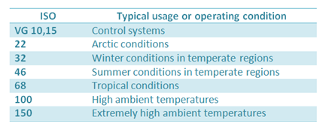
UNIT 4: Classification of Hydraulic Fluids
ISO-VG (ISO Viscosity Grades)
ISO viscosity grades classify hydraulic fluids based upon their kinematic viscosity at 40^{O}C.

Slide 43
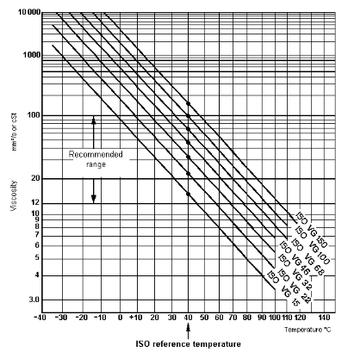
UNIT 4 : Classification of Hydraulic Fluids
Viscosity-temperature diagram,
Recommended Temp. Range

Slide 44
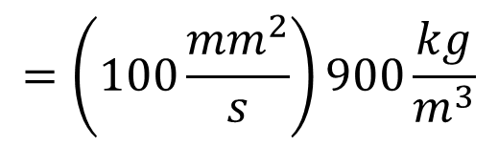

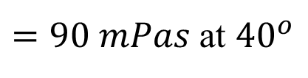
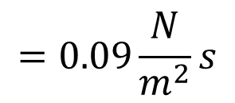
UNIT 4 : Classification of Hydraulic Fluids
Viscosity: (ISO-VG)
Specification of ISO-VG46 implies it is an oil of the viscosity class 46
Question:
Oil with specification ISO-VG100 has a density of 900kg/m³. What is the dynamic viscosity (η)?
Answer:
$$=\left(100\frac{{mm}^{2}}{s}\right)900\frac{kg}{m^{3}}$$
$$=0.09\frac{N}{m^{2}}s$$
$$η=ν.ρ$$
$=90 mPas$ at ${40}^{o}$

Slide 45
UNIT 4 : Classification of Hydraulic Fluids
SAE Viscosity Grade
  SAE VG gives no indication of quality and suitability of oil for a given application.
  According to SAE, there are two basic types of oil:
  Single grade
  Multi-grade

Slide 46
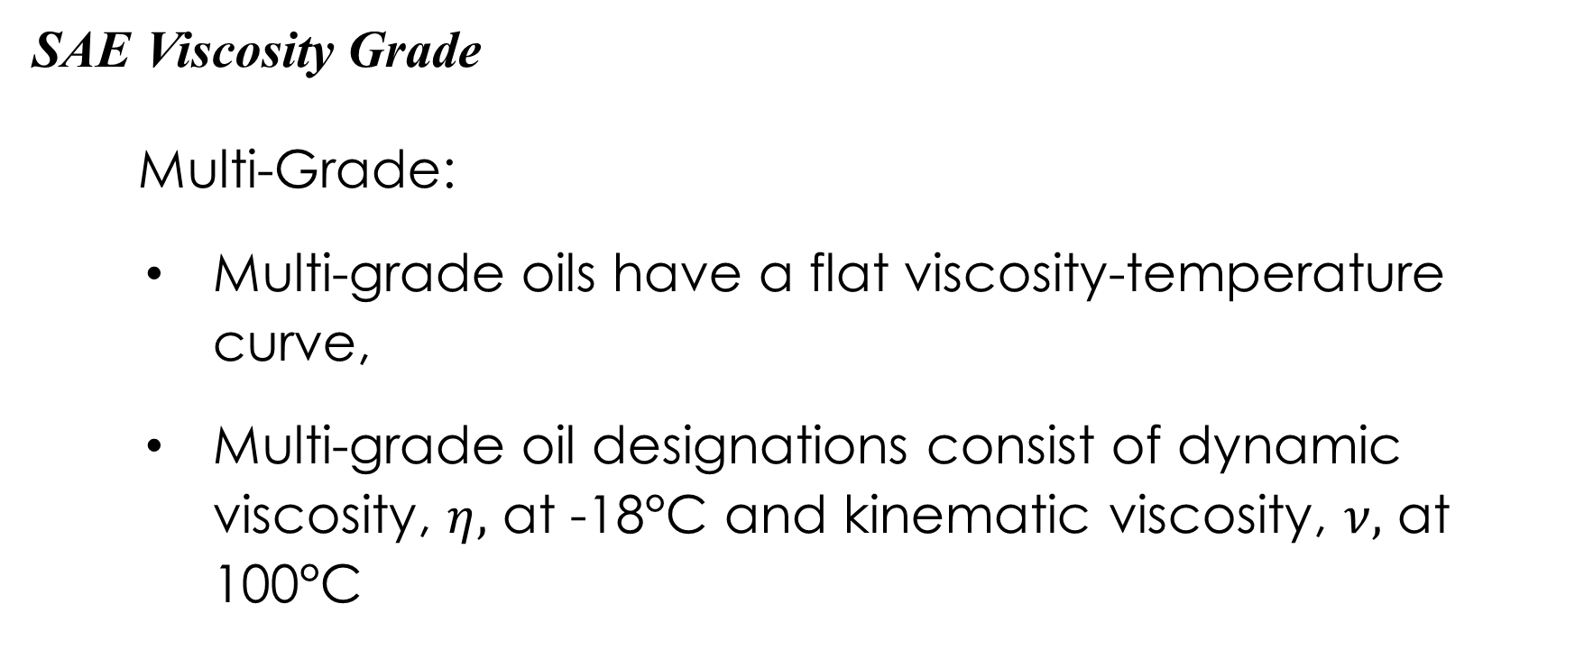
UNIT 4 : Classification of Hydraulic Fluids
SAE Viscosity Grade
Multi-Grade:
Multi-grade oils have a flat viscosity-temperature curve,
Multi-grade oil designations consist of dynamic viscosity, $η,$ at -18°C and kinematic viscosity, $ν,$ at 100°C

Slide 47
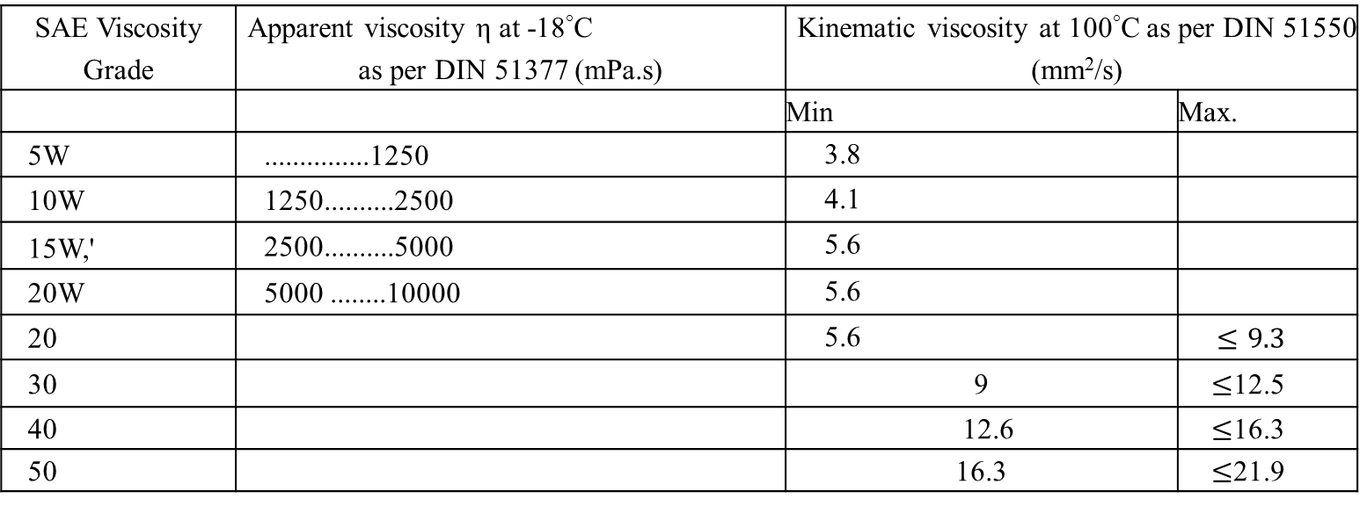
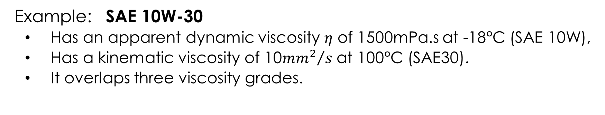
UNIT 4 : Classification of Hydraulic Fluids
Example: SAE 10W-30
Has an apparent dynamic viscosity $η$ of 1500mPa.s at -18°C (SAE 10W),
Has a kinematic viscosity of 10${{mm}^{2}}/s$ at 100°C (SAE30).
It overlaps three viscosity grades.
SAE Viscosity Grade | Apparent viscosity η at -18°C as per DIN 51377 (mPa.s) | Kinematic viscosity at 100°C as per DIN 51550 (mm²/s)
 |  | Min | Max.
5W | ...............1250 | 3.8
10W | 1250..........2500 | 4.1
15W,' | 2500..........5000 | 5.6
20W | 5000 ........10000 | 5.6
20 |  | 5.6 | $$≤9.3$$
30 |  | 9 | $≤$12.5
40 |  | 12.6 | $≤$16.3
50 |  | 16.3 | $≤$21.9

Slide 48
UNIT 4: Additives
Improve the properties of mineral oils based hydraulic fluids,
Types of additives:
viscosity index improver (VI),
oxidation and corrosion inhibitors,
high-pressure additives (EP), and
detergents and dispersants

Slide 49
UNIT 4: Additives
Properties of Fluid improved by additives:
  viscosity-temperature relationship,
  resistance of the oil to aging
  corrosive protection capacity,
  load carrying capacity in the mixed frictional state,
  stock point,
  foaming tendency, and
  air releasing capacity.

Slide 50
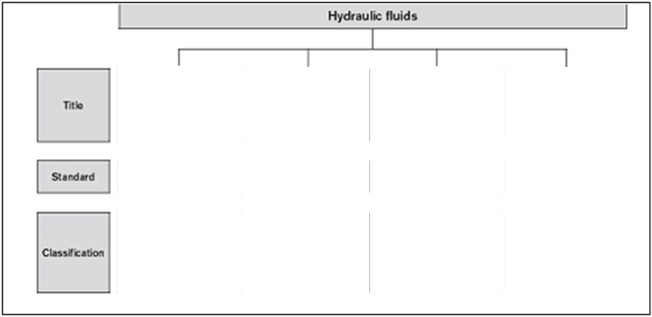
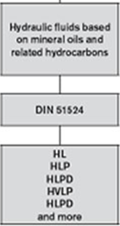
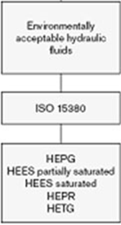
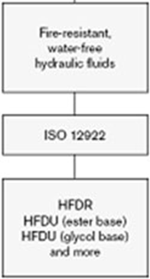
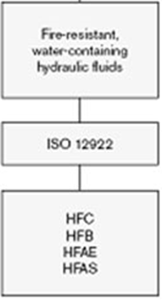
UNIT 4: Selection of Hydraulic Fluids
Based on compliance with the minimum requirements of DIN 51524

Slide 51
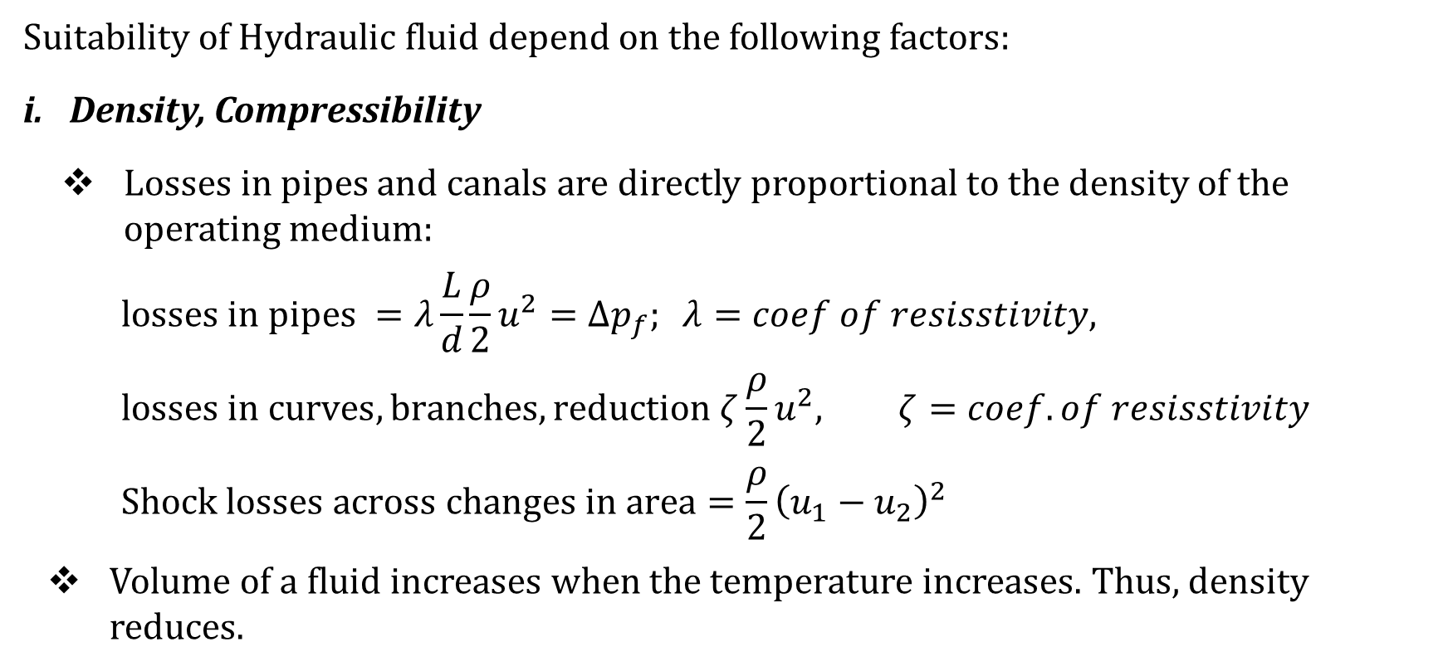
UNIT 4: Selection Criteria of Hydraulic Fluids
Suitability of Hydraulic fluid depend on the following factors:
Density, Compressibility
Losses in pipes and canals are directly proportional to the density of the operating medium:
$$losses in pipes =λ\frac{L}{d}\frac{ρ}{2}u^{2}=Δp_{f}; λ=coef of resisstivity,$$
$$losses in curves, branches, reduction ζ\frac{ρ}{2}u^{2}, ζ=coef. of resisstivity$$
$$Shock losses across changes in area=\frac{ρ}{2}{\left(u_{1}−u_{2}\right)}^{2}$$
Volume of a fluid increases when the temperature increases. Thus, density reduces.

Slide 52
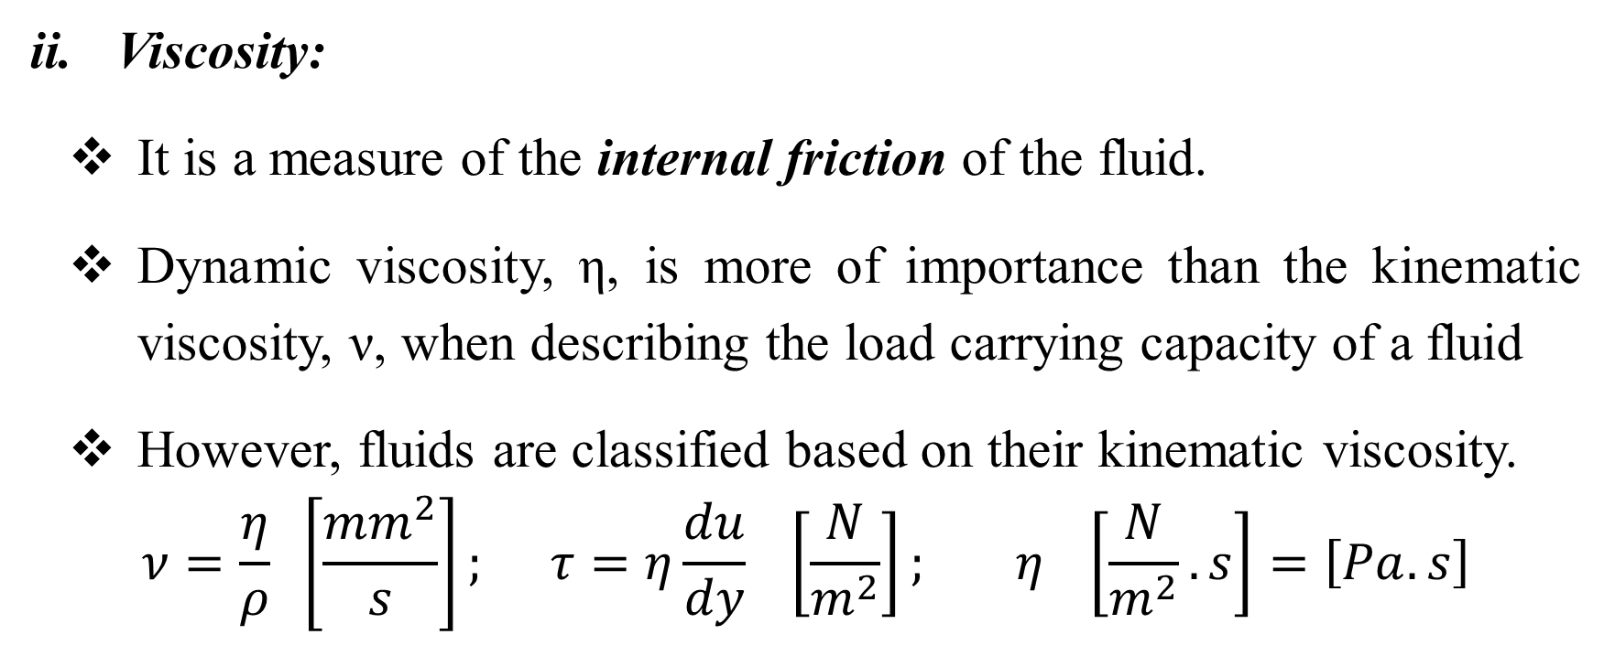
UNIT 4 : Selection Criteria of Hydraulic Fluids
Viscosity:
It is a measure of the internal friction of the fluid.
Dynamic viscosity, η, is more of importance than the kinematic viscosity, ν, when describing the load carrying capacity of a fluid
However, fluids are classified based on their kinematic viscosity.
$$ν=\frac{η}{ρ} \left[\frac{{mm}^{2}}{s}\right]; τ=η\frac{du}{dy} \left[\frac{N}{m^{2}}\right]; η \left[\frac{N}{m^{2}}.s\right]=\left[Pa.s\right]$$

Slide 53
UNIT 4 : Selection Criteria of Hydraulic Fluids
Viscosity:
Permissible viscosity range of a complete systems takes account of the permissible viscosity of all components,
Optimum operating viscosity range of each component should be kept within the permissible temperature range by:
either cooling or
heating, or both

Slide 54
UNIT 4 : Selection Criteria of Hydraulic Fluids
Viscosity:
Viscosity at operating temperature determines:
the response characteristics of closed control loops,
stability and damping of system,
the efficiency factor and
the degree of wear,

Slide 55
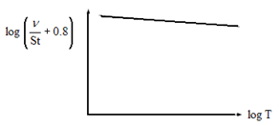
UNIT 4 : Selection Criteria of Hydraulic Fluids
Viscosity: (Viscosity-Temperature Relationship)
Viscosity drops when the temperature increases and rises when the temperature decreases,
Fluids with a low slope are suitable when used as hydraulic fluid,
A high VI means less temperature dependence

Slide 56
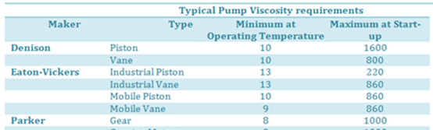
UNIT 4 : Selection Criteria of Hydraulic Fluids
Determining the correct viscosity grade for a particular application: Note
Start (maximum) viscosity at minimum ambient temperature,
Minimum viscosity at maximum expected operating temperature,
Permissible and optimum viscosity range for system components.

Slide 57
UNIT 4 : Selection Criteria of Hydraulic Fluids
Viscosity: (Viscosity-Pressure Relationship)
This relationship is responsible for the loading ability of lubricating fluids,
increase in viscosity with an increase in pressure has a self-strengthening effect.

Slide 58
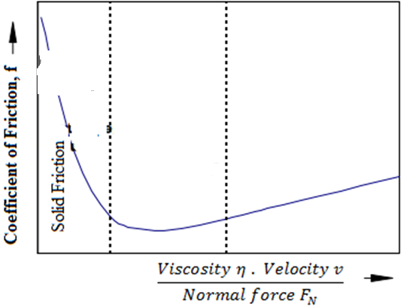

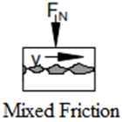

UNIT 4 : Selection Criteria of Hydraulic Fluids
Wear protection capability
Figure 4: Stribeck’s curve
Hydrodynamic lubrication requires high relative speeds between objects,
From start to final speed, the objects experience:
Solid friction state,
Mixed friction state,
Fluid friction state.

Slide 59

UNIT 4 : Selection Criteria of Hydraulic Fluids
Wear protection capability
Hydrodynamic lubrication: $η$ is the determining factor for the protection of wear,
In mixed frictional state:
$η$ should be above a critical value, in order to
Be able to keep the two rubbing surfaces apart, and
Thus, prevent wear.

Slide 60

UNIT 4 : Selection Criteria of Hydraulic Fluids
In mixed frictional state, should $η$ drop below a critical value and therefore unable to keep the two rubbing surfaces apart, then protection of wear would depend upon:
Chemical reactions on the surfaces,
Ability of the hydraulic fluid to spread over the surfaces, and
Presence of wear-protective additive

Slide 61

UNIT 4 : Selection Criteria of Hydraulic Fluids
Dissolution of Gases
Pressure fluids do dissolve a certain proportion of gases,
Capacity to dissolve these gases is proportional to the pressure if the pressure is less than 300bar and
Amount of gas dissolved is expressed by Dalton equation:
$$V_{G}=V_{f}\left(\frac{p}{p_{0}}\right)a_{N}$$
$$V_{G}=volume of gas dissolved V_{f}=volume offluid$$
$$p=absolute pressure, p_{0}=atmospheric pressur$$
$$a_{N}=Bunsen coefficient$$

Slide 62
UNIT 4 : Selection Criteria of Hydraulic Fluids
Cavitation
Due to dissolved gases or air coming out of a fluid forming bubbles,
Even if dissolved gases are not present, the fluid may ''boil'' when its pressure becomes too low, or its temperature too high.
Evaporation or boiling occurs at atmospheric temperature when the pressure is reduced below the saturation vapour pressure,
This can result out of a higher fluid velocity,
Actual problem is the high explosive nature of these gases near surfaces when the fluid re-enters a high pressure zones.

Slide 63
UNIT 4 : Selection Criteria of Hydraulic Fluids
Cavitation can take place in:
a. suction pipe lines and canals of pumps,
Causes: Lower absolute pressure due to:
  losses in fittings, curves, reduced cross-sectional areas,
  long suction heights,
  higher velocities.
Effects: erosion of parts, power losses, high noise, pressure shocks etc.
b. Throttles, orifices, etc.
Causes: Lower pressures due to high velocities
Effects: high noise, erosion, instability of their controls, change in the flow characteristics

Slide 64
UNIT 4 : Selection Criteria of Hydraulic Fluids
Cavitation Protective Measures:
Choice of material with resistance to erosion on surface,
Reducing the pressure differences on a single pressure reducing element (serial connection of such elements),
Deviating the cavitation’s jet away from critical areas

Slide 65

UNIT 4 : Selection Criteria of Hydraulic Fluids
Material compatibility
Hydraulic fluid must not negatively affect the materials of components such as coatings, seals, hoses, metals and plastics

Slide 66
UNIT 4 : Selection Criteria of Hydraulic Fluids
Aging (oxidation and Polymerisation)
Oxidation is a reaction with oxygen to form acidic bases.
Polymerisation is the increase in the length of the C-H chain, and it leads to the formation of sludge,
Acceleration of aging can be due to:
High operating temperatures.
Presence of foreign air,
Presence of water and other impurities,
Presence of metallic catalyst (mostly Cu and Cu-alloys)

Slide 67
UNIT 4 : Selection Criteria of Hydraulic Fluids
Aging (oxidation and Polymerisation) Neutralisation Number:
It is a scale for determining the aging state of fluids,
it specifies the amount of⁻KOH necessary to neutralise 1g of the fluid.

Slide 68
UNIT 4 : Selection Criteria of Hydraulic Fluids
Air separation ability (ASA)
Property of a hydraulic fluid to separate undissolved air
Hydraulic fluids always contain dissolved air,
During operation, dissolved air may be transformed into undissolved air, leading to cavitation,
air separation capacity depends on the viscosity, temperature, basic fluid and aging,
It cannot be improved by additives.

Slide 69
UNIT 4 : Selection Criteria of Hydraulic Fluids
Demulsifying ability and water solubility
The capacity of a hydraulic fluid to separate water at a defined temperature is known as demulsifying ability,
For larger systems with permanent monitoring, a demulsifying fluid with good water separation capability (WSC) is recommended

Slide 70
UNIT 4 : Selection Criteria of Hydraulic Fluids
Filterability
Filterability describes the ability of a hydraulic fluid to pass through a filter, removing solid contaminants,
Filterability is a basic prerequisite for cleanliness, servicing and filtration of hydraulic fluids

Slide 71
UNIT 4 : Selection Criteria of Hydraulic Fluids
Additivation
Properties of fluids can be modified with suitable additives,
Distinction is made for fluids between heavy metal-free and heavy metal-containing (generally zinc) additives systems,
Both additive systems are most often incompatible with each other,
Increasing additivation generally leads to deteriorated air separation ability (ASA) and water separation capability (WSC) of the hydraulic fluid

Slide 72
UNIT 4 : Selection Criteria of Hydraulic Fluids
Measures taken when changing type of fluid:
thoroughly cleaning of the plant,
Replacing the seals,
Inspect / test the suction behaviour, filter and container construction,
Inspect the paintings of the container

Slide 73

Thank You
For any concerns, please contact
elearning@knust.edu.gh
elearningknust@gmail.com
0322 191132

